Slide 1
Symbolism / Tone / Syntax/ Denotation / Connotation
Literary Devices

Slide 2
SYMBOLISM
A literary device that uses an object or action to represent something more than it’s literal meaning.

Slide 3
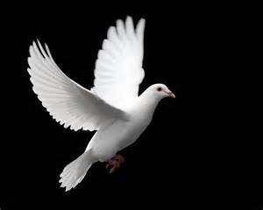
What does a dove symbolize?

Slide 4
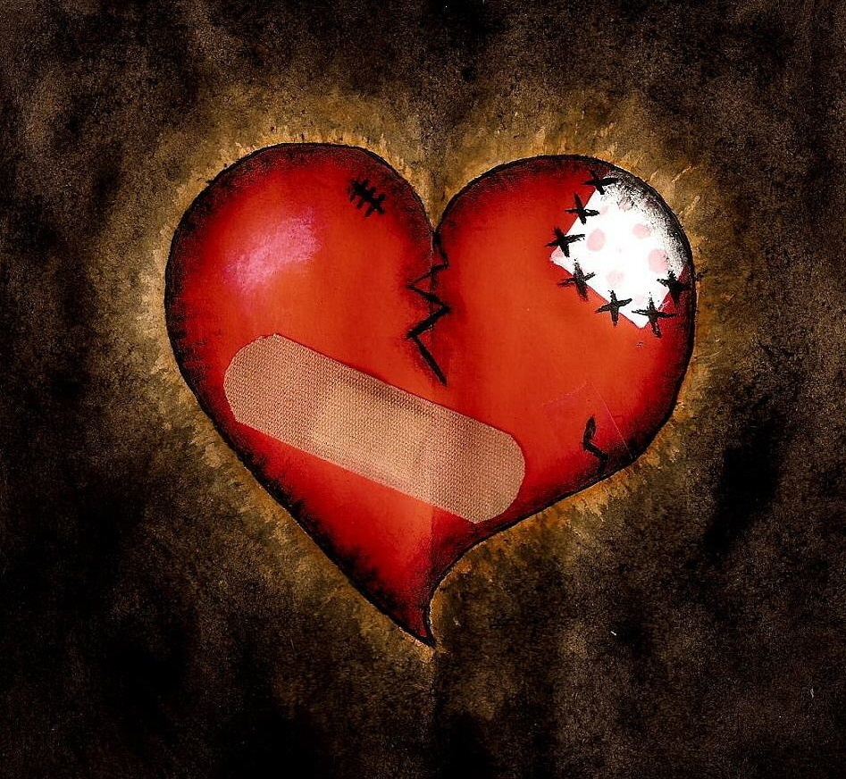
What could this image symbolize?

Slide 5
Ah Sunflower – William Blake
“Ah Sunflower, weary of time,
Who countest the steps of the sun;
Seeking after that sweet golden clime
Where the traveller’s journey is done;”
What does Sunflower symbolize?

Slide 6
Wuthering Heights Excerpt – Emily Bronte
“My Love for Linton is like the foliage in the woods. Time will change it; I’m well aware, as winter changes the trees. My love for Heathcliff resembles the eternal rocks beneath a source of little visible delight, but necessary.”
What does “foliage of leaves” symbolize? How does she feel about Linton?
What does “eternal rocks” symbolize? How does she feel about Heathcliff.

Slide 7
TONE
The general attitude of the author toward the reader or the subject matter of a literary work.

Slide 8
Read the following slide in 3 different ways and see how tone changes even when the dialogue doesn’t.
- Man proposing to a woman
- Assassins
- A parent to a teenager who came home late

Slide 9
You’re late!
I know. I couldn’t help it.
I understand.
I knew you would.
I have something for you.
Really? What?
This!

Slide 10
Use the tone words handout to determine the tone of the next two slides.

Slide 11
We refused to get out of the bed when the bugle blew in the morning, we fought against scrubbing our teeth in public to music, we sneered when the flag was ceremoniously lowered at sunset, we avoided doing a good deed a day, we complained loudly about the food…and we bought some chalk and wrote all over the Recreation Cabin “We hate Camp Hi-Wah.”
- Ruth McKenny’s “A Loud Sneer For Our Feathered Friends.

Slide 12
It has been called the House of God. It has been called the High One. The Cold One. The White One. On close acquaintance by climbers, it has been called a variety of names rather less printable. But to the world at large it is Kilimanjaro, the apex of Africa and one of the great mountains on the earth.
- James Ramsey Ullman’s “Kilimanjaro”

Slide 13
DENOTATION
The dictionary or literal meaning of a word.

Slide 14
CONNOTATION
The emotional association that a word carries.

Slide 15
Give the Denotation and at least 3 Connotations
Dark
Light
Vacation
Basement
Mountain top
Snake
Bright
Soldier
Prisoner
Rose
Sun
Ocean
Knife
Father
Peace
Winter

Slide 16
SYNTAX
The way an author chooses to group words within the text.

Slide 17
Something there is that doesn’t love a wall.
There is something that doesn’t love a wall.
Had we but world enough, and time, this coyness, lady, were no crime.
This coyness, lady, were no crime, had we but world enough, and time.

Slide 18
In Our Time – Ernest Hemingway
What can you observe by the words Hemingway chooses and the way he groups them?

Slide 19
If the world should choose to end there be nothing but brightness and love in the eye of my heart for thee.

Slide 20
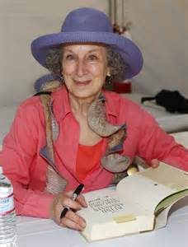
Margaret Atwood
Born: 1939, Ottowa, Canada
Occupation: Award winning Author, Poet, Activist
Education: Victoria College
Works: The Handmaid’s Tale, The Edible Woman

Slide 21
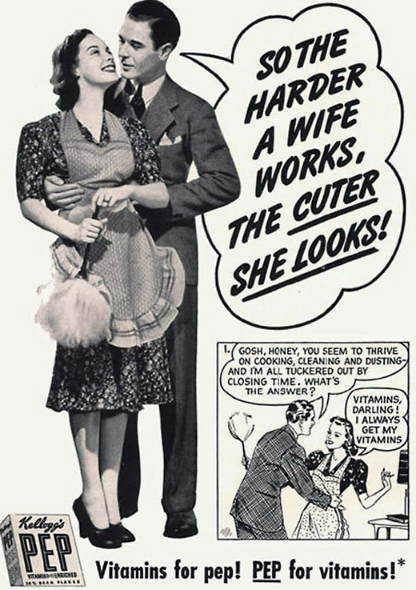

Slide 22
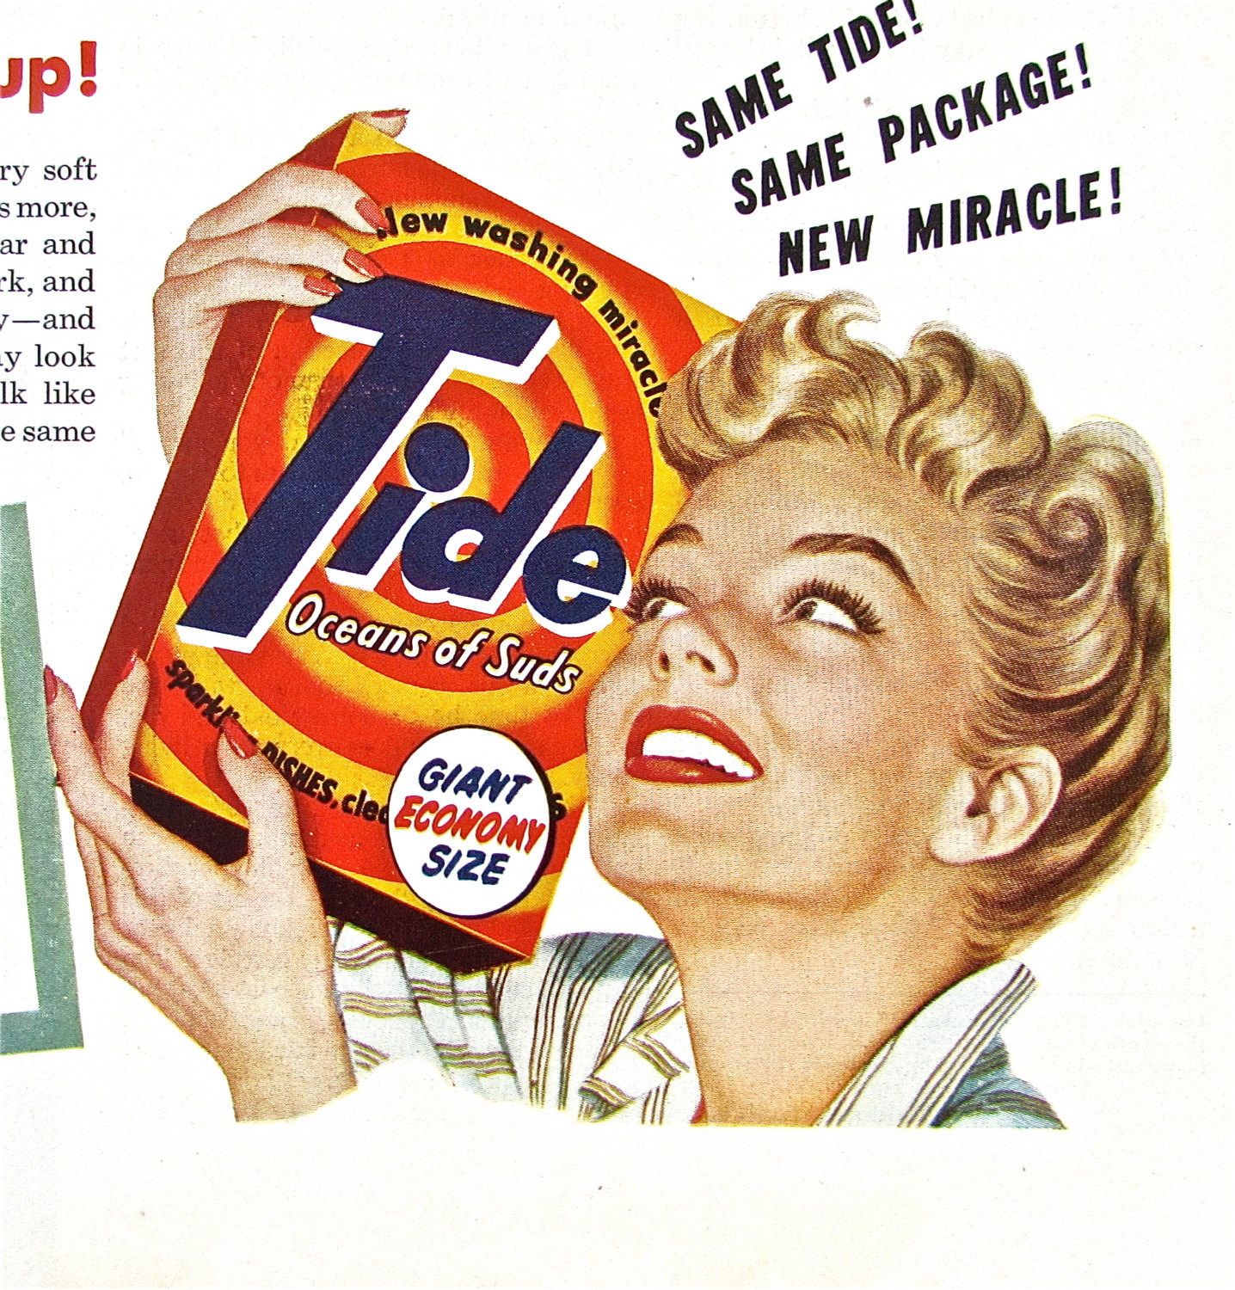

Slide 23
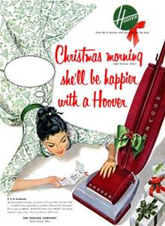

Slide 24
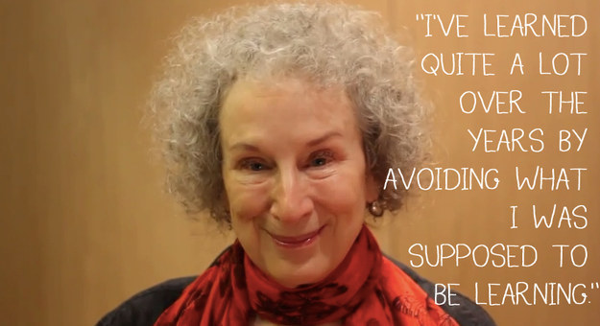

Slide 25
“Spelling” By Margaret Atwood
Annotate EACH stanza. Comb through the poem several times. ANALYZE / OBSERVE
Theme
Tone
Symbolism
Syntax / Imagery
What point is the author trying to convey?
Allusion – Does Atwood allude to past events? If so, which and why does she make the comparison?
What is the overall meaning of her metaphor.

