Slide 1
What is Theme?

Slide 2
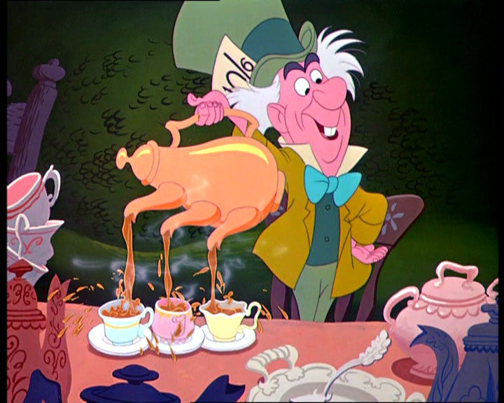

Slide 3
Expect the Unexpected/ Welcomed Chaos / The Randomness of Life
The off balanced shape of the cake stacked high without regard to consequence.
Stripes and polka dots on the cake.
Out of the ordinary characteristics like the 3 spouts on the tea pot.

Slide 4
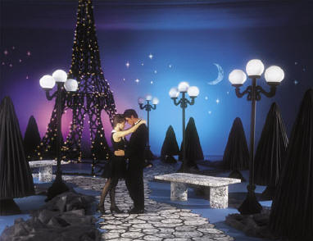

Slide 5
Make the most of life / The last night for romance
Hollywood theme
Red carpet events are big and very rare for most, so make the most of this one night.
Parisian Theme
The moon is high, symbolizing midnight, where right before we begin a new day.

Slide 6
Theme
The fundamental and universal idea explored in a literary work.

Slide 8
Transformation / Looking deeper into the true meaning
The Grinch was a loner who hated all things happy, especially Christmas.
He TRANSFORMED from a grouch into someone who loved the Whos and loved Christmas.
The Grinch thought if he could take their Christmas away, then they would have nothing to celebrate. But when they still sang and rejoiced he found that there was a deeper meaning than just presents and food.

Slide 10
Good vs. Evil Prejudice
The good: Tom Robinson, Boo Radley and the Finch Family each represent good in different ways. Some fight for it and others are inherently good
The evil: The town’s prejudice and racist views, Bob Ewell
The main prejudice is Tom Robinson’s unfair trial.
The second is how the town reacts to Boo Radley.
The third is how Mr. Raymond must present himself due to his black mistress.

Slide 12
Inhumanity towards others
Anne Frank chronicles her family being forced to hide from the Nazi’s. They are intolerant of those that seem different from themselves.
Elie Wiezel semi-autobiographical novel tells of how Nazi’s starve them, hang a young boy and toss babies into the air for target practice.

