Slide 1
THEME
“There are patterns which emerge in one’s life, circling and returning anew, an endless variation of a theme.”
- Jacqueline Carey, author

Slide 2
THEME
The central concept or underlying idea in a literary work.
Life lesson, meaning, moral, or message about life or human nature that is communicated by a literary work.
In other words…
Theme is what the story teaches readers.
The BIG IDEA or MORAL LESSON.

Slide 3
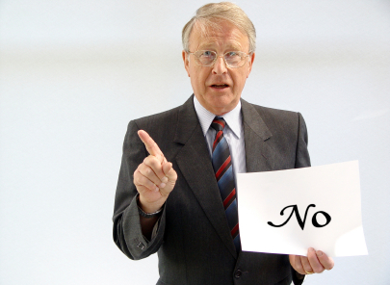
It is NOT…
A Topic…
Love
Family
Tradition
Racism
A Topic is a subject or idea dealt wih within the text.
No, no, no, no, NO!!!

Slide 4
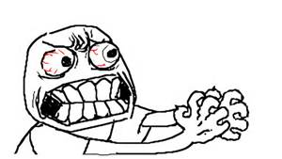
SERIOUSLY??!!

Slide 5
THEME is…
…the POINT being made ABOUT the TOPIC.
Love? Sure...now what lesson or moral is the author trying to tell me about love?

Slide 6
THE HUNGER GAMES
TOPIC
The subject
Less specific
“Fear”
“Control”
THEME
The BIG IDEA
Expanded thinking
Fear can be used as a tactic to control

Slide 7
Topic is too broad and vague
Love
Family
Ever-lasting
Platonic
Love of a child
Love of one’s self
Obsessive
Sexual
Beginning
Whirlwind
Dysfunctional
Love of family
Traditional
Non-traditional
Blended
Social
Parents / Siblings / Grandparents

Slide 8
BUT…TOPIC is not...
…being a good person
…believing your beautiful
It is...
...Humanity / Benevolence / Kindness
Beauty / Confidence / Self love

Slide 9
A GOOD THEME…
...teaches a VALUABLE lesson about LIFE.
Love...(Topic)
True love can endure through all obstacles (Theme / author’s lesson)

Slide 10
Generic Themes
“Never judge a book by its cover”
“Slow and steady wins the race”

Slide 11
Step 1: LIST TOPICS
Read (watch or listen) to your text and make sure you understand what you read.
List the TOPICS in the piece.
Love
Family
Hope
Forgiveness

Slide 12
Step 2: TEXTUAL EVIDENCE
Use textual evidence from the text to support the topics chosen.

Slide 13
Step 3: THEME SENTENCE
Pick a topic(s), and use the contextual evidence to create a sentence about what overall concept or lesson the author believes about their text.
(The author’s name) believes that….

Slide 14
Step 4: FIND THEME
THEN…go back through the sentence and mark out words until you find your THEME!

Slide 15
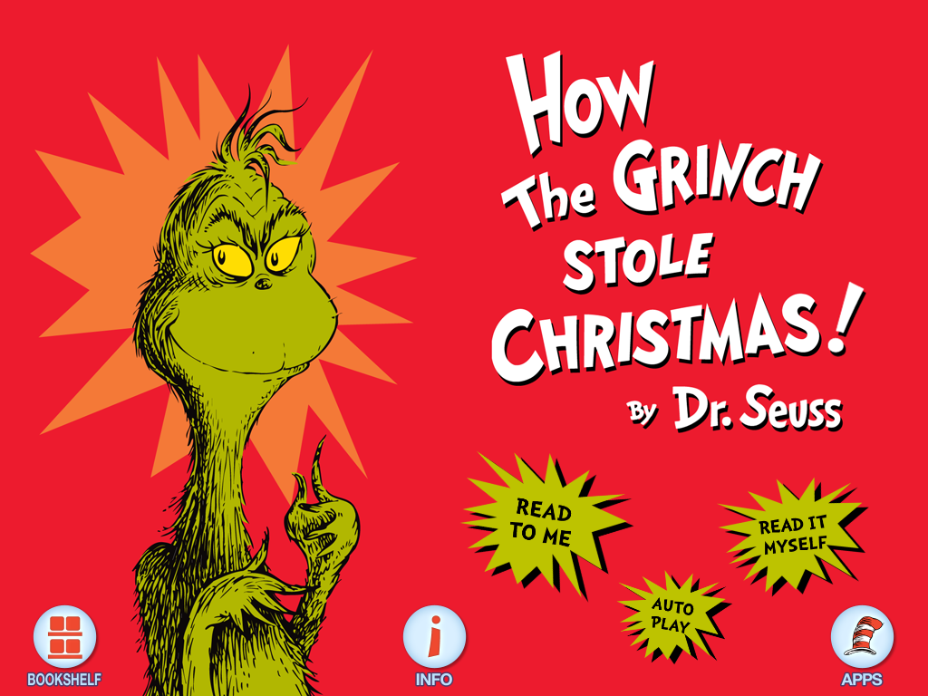
Finding Theme…

Slide 16
TOPICS
Transformation
Selflessness
Christmas
Sacrifice
Materialism / Commercialism

Slide 17
TEXTUAL EVIDENCE
“That the Grinch’s small heart grew 3 sizes that day.
“Every Who in Whoville was singing without any presents at all.”
“Every Who down in Whoville loved Christmas a lot!”
The Grinch risked his life to save his dog and the sleigh with Who toys and food.
“Maybe Christmas didn’t come from a store…maybe it was about a little bit more.”

Slide 18
THEME SENTENCE
Dr. Seuss believes that through transformation and selflessness, we can find the true spirit of Christmas to be less about material things and more about togetherness.
Dr. Seuss believes that through transformation and selflessness, we can find the true spirit of Christmas to be less about material things and more about togetherness.

Slide 19
And now we have…THEME
Selflessness at Christmas is greater than material things.
Togetherness is the true gift of Christmas.
True meaning of Christmas can’t be bought.

Slide 20
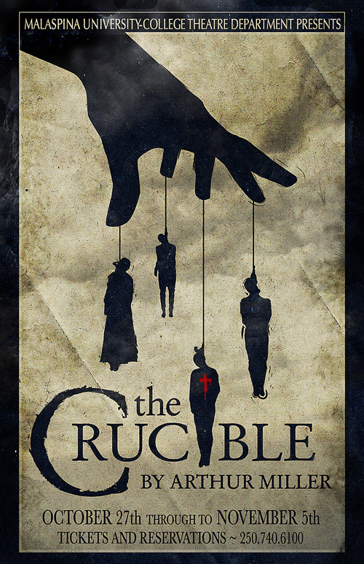
Try these familiar stories…

Slide 21
4-Step Format
1) Find several topics
2) Try to remember textual evidence
3) Write a sentence using the author’s name
4) Cross out words and rearranage to find the THEME

Slide 22
Finding “Brave” Theme
1st Group lists FIVE topics
2nd Group lists textual evidence for EACH topic
3rd Group writes out “theme sentence”
1st Group crosses out words and comes up with the THEME

