Slide 1
Inference
What you SEE + What you already KNOW

Slide 2
Inference
To draw a reasonable conclusion from the information presented

Slide 3
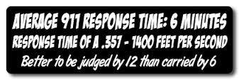
What can you infer about this driver?

Slide 4
What can you infer about this driver?

Slide 7
Owners of the car
Comic Con
Vulcan Salute
Star Trek Shirt

Slide 8
Read the following and answer the questions
“I think we should tell them,” the guy said, as the couple sat opposite one another.
“Not yet. I don’t want them dragged into this just yet. They won’t understand,” she replied.
“It’s not like they didn’t see this coming.”
“I didn’t see this coming.”
“You didn’t see a lot of things,” he admitted quietly, while staring at his hands.
“Trust me, I know,” she retorted with a clipped tone as she slid back from the table and stood.

Slide 9
Question
Make statements
Observe
Visualize
Interpret / analyze
THINK OUT LOUD

