Slide 1
Iceberg Writing
Hemingway

Slide 2
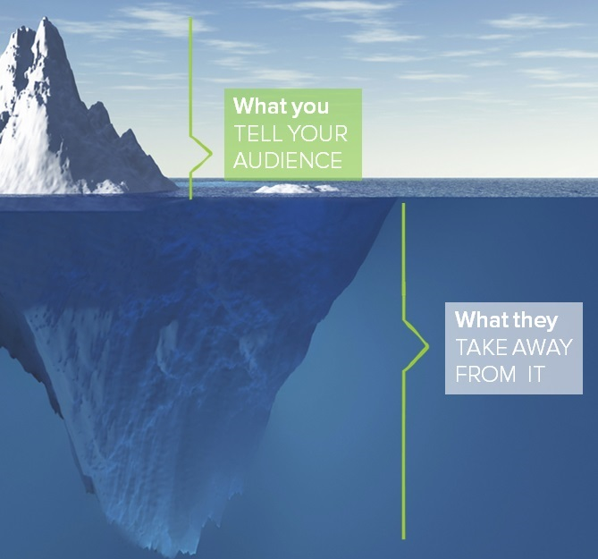
"I always try to write on the principle of the iceberg. There is seven-eighths of it underwater for every part that shows."
Ernest Hemingway

Slide 3
HLWE - Discussion
Groups of 5 or 6
Each member must present at least 5 comments
Group must discuss EACH comment
Need Group leader & Note-taker
Note-taker must keep up with how many comments from each person
Discuss the Iceberg Writing Method and what you did or didn’t like about it.
How would the dynamics of the story change if the American had mentioned the word “abortion” at the beginning? Would it be a better story...or worse?

