Slide 1
Analyze This
2/4/16

Slide 2
Analyze This
9 iconic photos with captions have been placed around the room. Spend several minutes at each photo, reading the caption, making observations in your notebook, then choose 1 photo and write about the following:
Why is this photo iconic? What emotions does a photo like this bring out in others and in you. Even if you aren’t knowledgeable about the events surrounding it, why has (or will) it stand the test of time? Truly analyze and critique the photo as if you were a photojounalist and what that photo has come to be symbolic for.

Slide 3
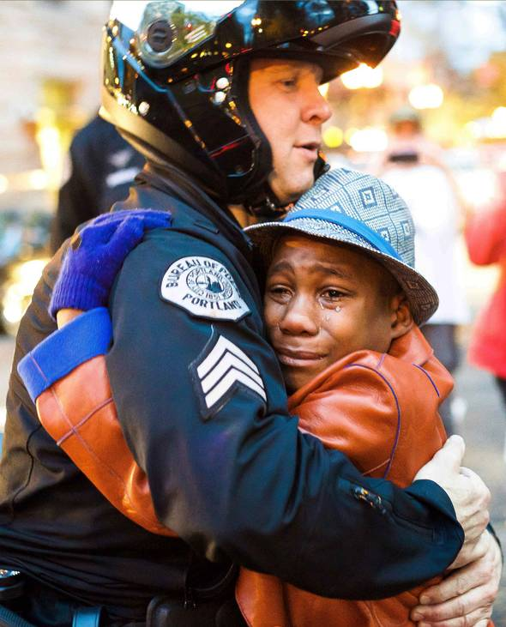
A Hug, November, 25th, 2014
The November 25 protest was held, along with many across the United States, in solidarity with the family of Michael Brown, the unarmed black teenager shot and killed by a white policeman in August, following a grand jury’s decision not to indict the officer.
Photographer Johnny Nguyen brought his camera to the protest and met a 12-year-old black boy named Devonte Hart, who was overcome with emotion.
“I saw tears running down Devonte’s face and a sign that said free hugs around his neck,” Nguyen, 20, recalls. “There was a lot going on, but my gut told right then and there to stay with this kid.”
Nguyen followed Devonte through the crowd and watched as a white Portland police officer named Bret Barnum looked at Devonte’s sign and asked, “Do I get one of those?” The pair hugged.

Slide 4
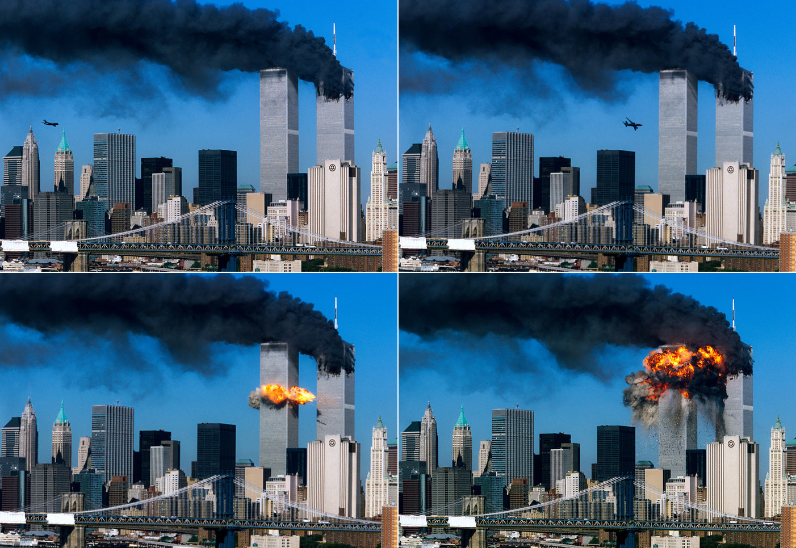

Slide 5
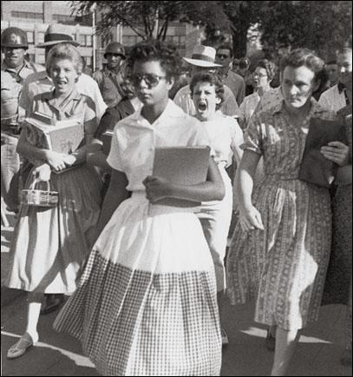
The Arkansas 9
The Little Rock Nine were the nine African-American students involved in the desegregation of Little Rock Central High School. Their entrance into the school in 1957 sparked a nationwide crisis when Arkansas governor Orval Faubus, in defiance of a federal court order, called out the Arkansas National Guard to prevent the Nine from entering. President Dwight D. Eisenhower responded by federalizing the National Guard and sending in units of the U.S. Army’s 101stAirborne Division to escort the Nine into the school on September 25, 1957. The military presence remained for the duration of the school year. On September 4, 1957, the Nine attempted to enter Central but were turned away by Arkansas National Guard troops called out by the governor. When Elizabeth Eckford arrived at the campus at the intersection of 14th and Park Streets, she was confronted by an angry mob of segregationist protestors. She attempted to enter at the front of the school but was directed back out to the street by the guardsmen. Walking alone, surrounded by the crowd, she eventually reached the south end of Park Street and sat down on a bench to wait for a city bus to take her to her mother’s workplace. Of her experience, Eckford later said, “I tried to see a friendly face somewhere in the mob—someone who maybe would help. I looked into the face of an old woman and it seemed a kind face, but when I looked at her again, she spat on me.”

Slide 6
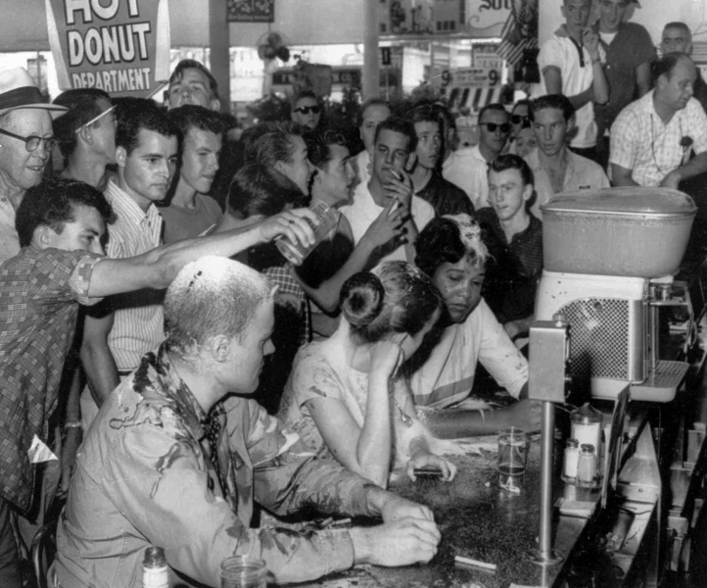
Woolsworth Sit-in, May 28th 1963
Iconic photograph of the injustice that occurred during the Civil Rights Period. Young white and black activists, John Salter, Joan Trumpauer, and Anne Moody sit-in at a “white’s only” counter in Woolworth's for lunch in Jackson, Mississippi. An angry mob yell racial slurs, shove and pour sugar, ketchup and mustard on them in protest.

Slide 7
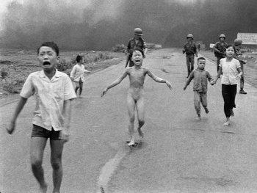
The Terror of War (Napalm Girl) – Huyn Cong Ut, 1973
The Pulitzer Prize winning photograph captures the devastation caused by American napalm bombing during the Vietnam War. The focal point of the image is Phan Thj Kim Phuc, the naked girl who ripped her clothes off after being severely burned on her back. Though controversial at the time because of its depiction of full-frontal nudity, the image brought the horror of the Vietnam War and its many innocent victims to the forefront of the world’s conscious.

Slide 8
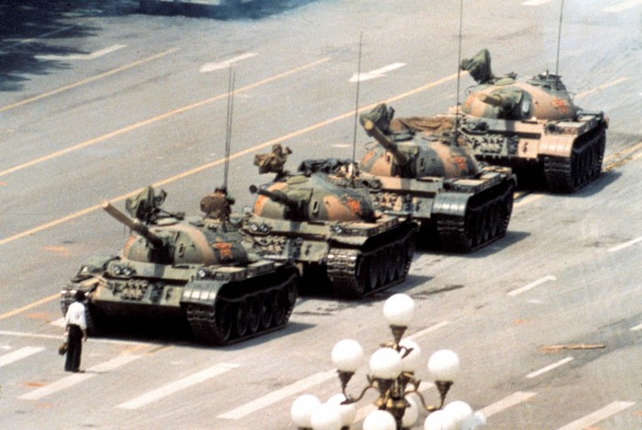
Tank Man, June 5th 1989
A man who stood in front of a column of tanks on June 5, 1989, the morning after the Chinese military had suppressed the Tiananmen Square protests of by violent force, became known as the Tank Man, Unknown Protester or Unknown Rebel. As the lead tank maneuvered to pass by the man, he repeatedly shifted his position in order to obstruct the tank's attempted path around him. The incident was filmed and seen worldwide.
Currently, there is no reliable information about the identity or fate of the unknown rebel.

Slide 9
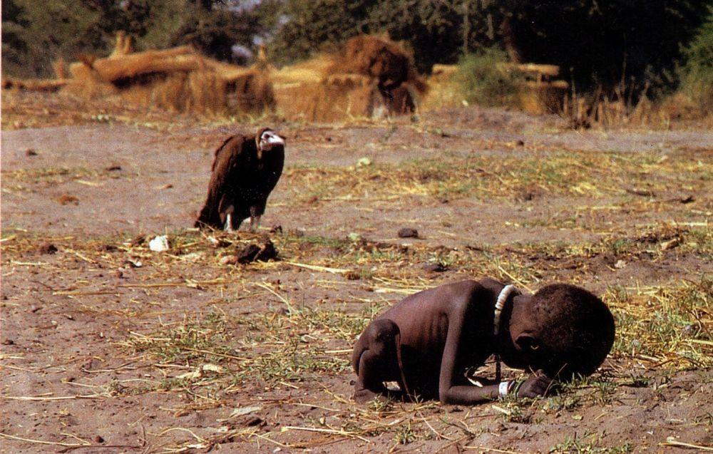
Starving Child and Vulture, Kevin Carter, 1993
The most haunting image on the most iconic images of photography, Kevin Carter captured the devastating famine in Sudan with a photograph of an orphaned toddler crawling to a UN feeding center while a vulture stalks her as prey. Carter won a Pulitzer Prize for his work but received harsh criticism for both the photograph and for not helping the child. A year later, gripped by the devastation and depression he had seen, Carter committed suicide.

Slide 10
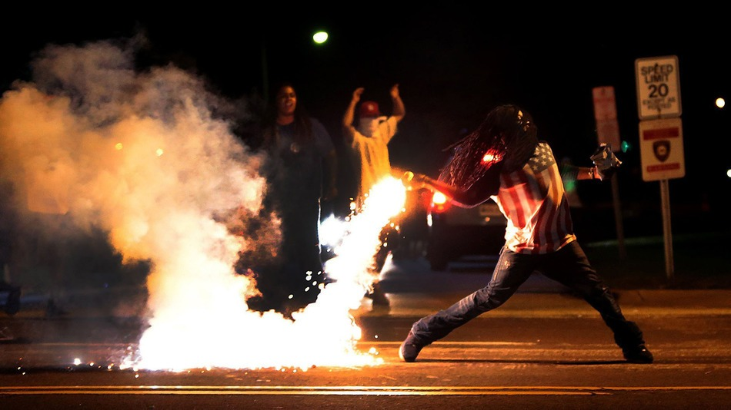
Who is America? August 13th, 2014
Taken and tweeted by St. Louis Post Dispatch photographer Robert Cohen, the photo seemed to sum up the anger felt by residents of Ferguson, where unarmed African-American teenager Michael Brown was shot dead by a still-unidentified police officer on Saturday night. “This is the best Rage Against The Machine album cover ever,” noted one Facebook commenter, comparing the photo to the anti-authoritarian images that adorned covers by the 1990s political rap-metal band. The symbolism of the photo was undeniable. The image depicts a protester hurling a flaming tear gas canister back in the direction of the police who fired it. The protester wears an American flag shirt and clutches a bag of potato chips — or some kind of snack chips — in his left hand while hurling the tear gas grenade with his right. The unidentified man in the Ferguson photo wears long dreadlocks which obscure his face, and — making the significance of the image complete — the man appears to be positioned in front of a “crime stoppers” sign.

Slide 11
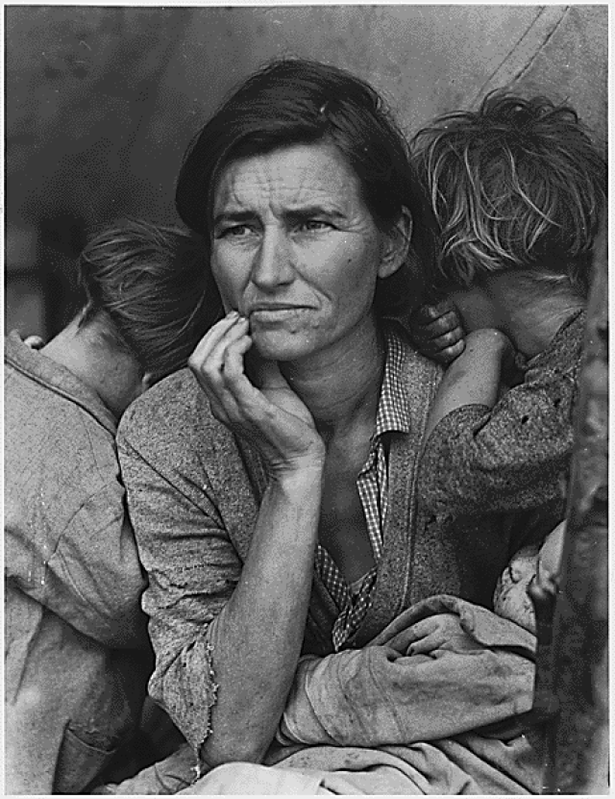
Migrant Mother, The Great Depression, 1936
In March 1936, after picking beets in the Imperial Valley, Florence Thompson and her family were traveling on the U.S. Highway towards Watsonville "where they had hoped to find work in the lettuce fields of the Pajaro Valley." On the road, the car timing chain snapped and they coasted to a stop just inside a pea-pickers' camp on Nipomo Mesa. They were shocked to find so many people camping there – as many as 2,500 to 3,500. A notice had been sent out for pickers, but the crops had been destroyed by freezing rain, leaving them without work or pay. Years later Florence told an interviewer that when she cooked food for her children that day little children appeared from the pea pickers' camp asking, "Can I have a bite?"
The family had been living on frozen vegetables and birds that their children had killed.

